Slide 1
INTERSHIP AT SKILL-LYNC
Project:-
Responsive Food and Restaurant website
Name:Jenil Popat
Email:-jenilpopat99@gmail.com

Slide 2
Objective:
The develop responsive website in using html , CSS , Java Script and Bootstrap.
Create Home, About Us , Explore Food , Reviews page.
This website provide resonsness we can use all kind of device .

Slide 3
Facilities:-
Order online on website
Contact us
Our different social media contact
User friendly interface

Slide 4
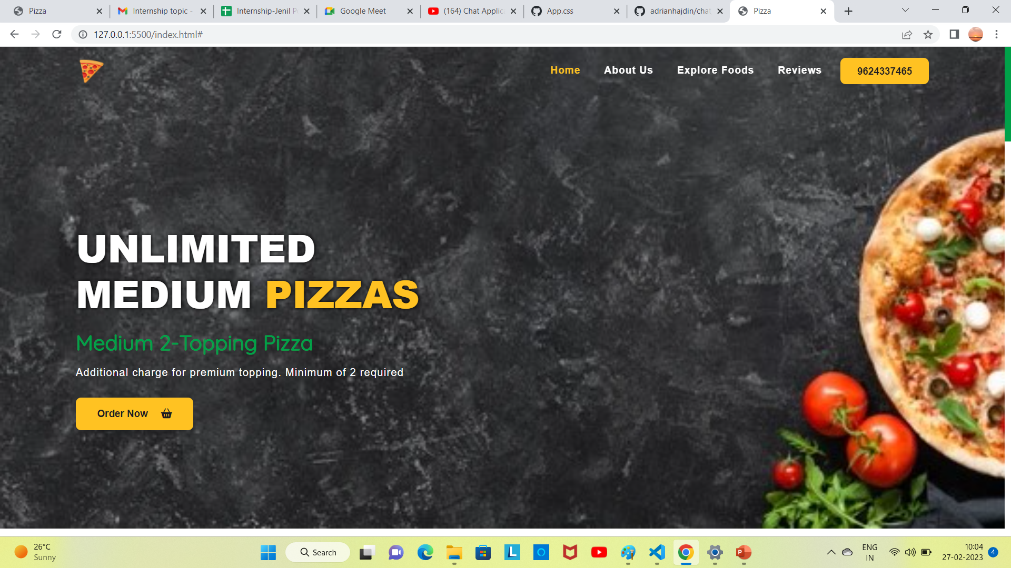
Some Screenshots of this project:

Slide 5
This is our website.
On website we can see custom nav bar and custom smooth scrolling , we use bootstrap for this but make custom css for this classis.
Also input different font
In our codding part header design, and dived 6 section top banner,our menu , about , explore-food ,testimonial , footer.

Slide 6
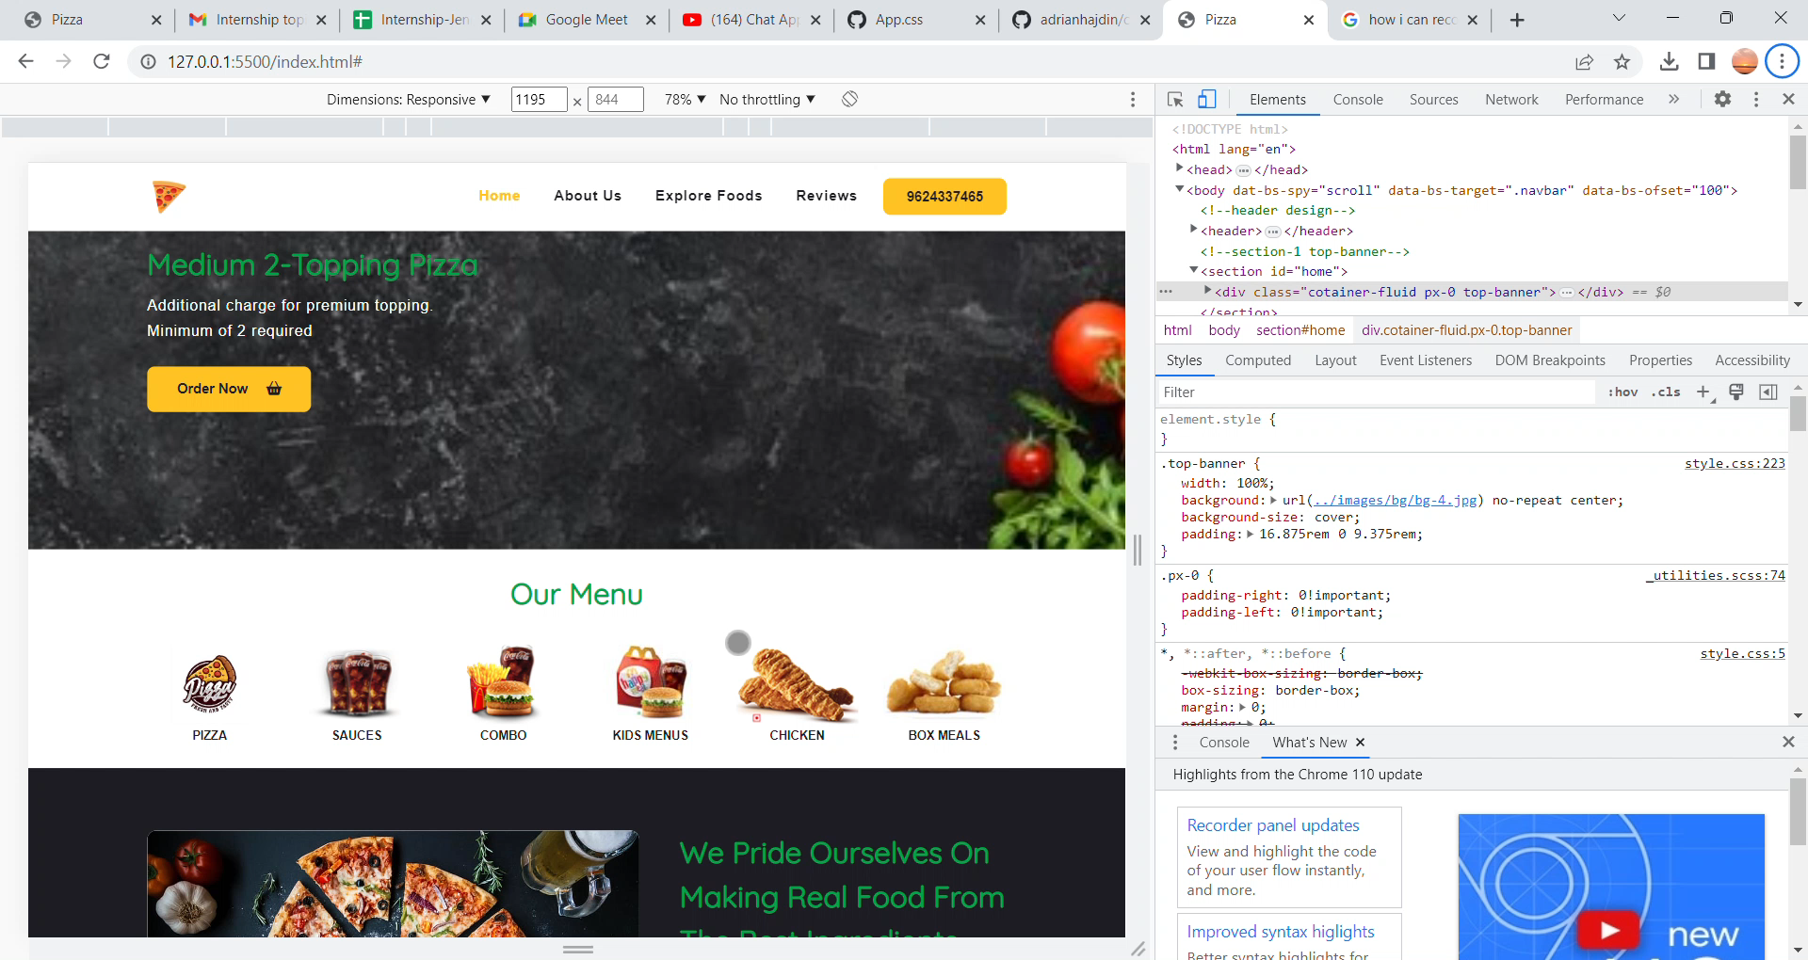
Responsive all kind of device

Slide 7


